Slide 1
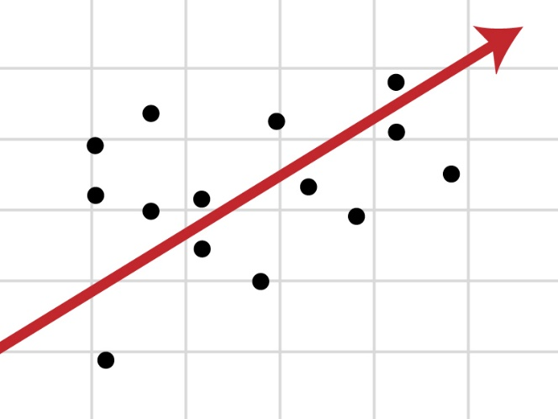
Regression Models
Taking our first steps to modelling data
Yordan Darakchiev
Technical Trainer
iordan93@gmail.com

Slide 2
sli.do #Data-Science

Slide 3
Table of Contents
Problem overview
Regression, classification
Machine learning: putting it all together
Linear regression
Motivation, derivation, usage
More involved example
Logistic regression
Motivation, usage

Slide 4
Problem Overview
Types of modelling

Slide 5
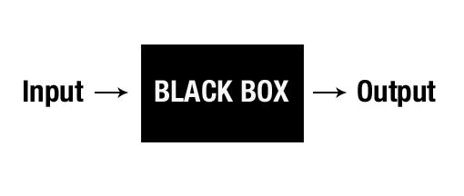
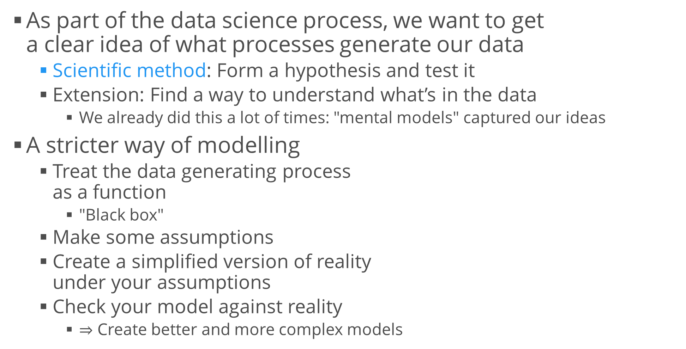
Data Modelling
As part of the data science process, we want to get a clear idea of what processes generate our data
Scientific method: Form a hypothesis and test it
Extension: Find a way to understand what’s in the data
We already did this a lot of times: "mental models" captured our ideas
A stricter way of modelling
Treat the data generating process as a function
"Black box"
Make some assumptions
Create a simplified version of reality under your assumptions
Check your model against reality
$⇒$ Create better and more complex models

Slide 6
A Quick Peek at Machine Learning
Machine learning is "making computers learn with experience, without being explicitly programmed"
Similar to how humans learn
It's all about models
ML follows the same processes as we’re going to do
ML algorithms are basically "function approximations"
Each algorithm does its own thing, i.e. has different assumptions, scope and performance
It's also about selecting the best model
There are many "helper algorithms" to do so – either fully automated or semi-automated
Visualization algorithms,
Fine-tuning algorithms
Model selection algorithms, etc.

Slide 7
A Quick Peek at Machine Learning (2)
There are a lot of classes of problems
The most commonly used two
Regression – model a function which returns a number (i.e. returns a continuous variable)
Example: predict the temperature tomorrow
Classification – model a function which tries to differentiate between two (or more) predefined types of things
Example: predict if an image is of a cat or not
The essence: once we assume a model, we can make predictions about function outputs
Thus, we can capture patterns in an otherwise unpredictable world

Slide 8
Linear Regression
Predict continuous values… and torture first-semester students

Slide 9
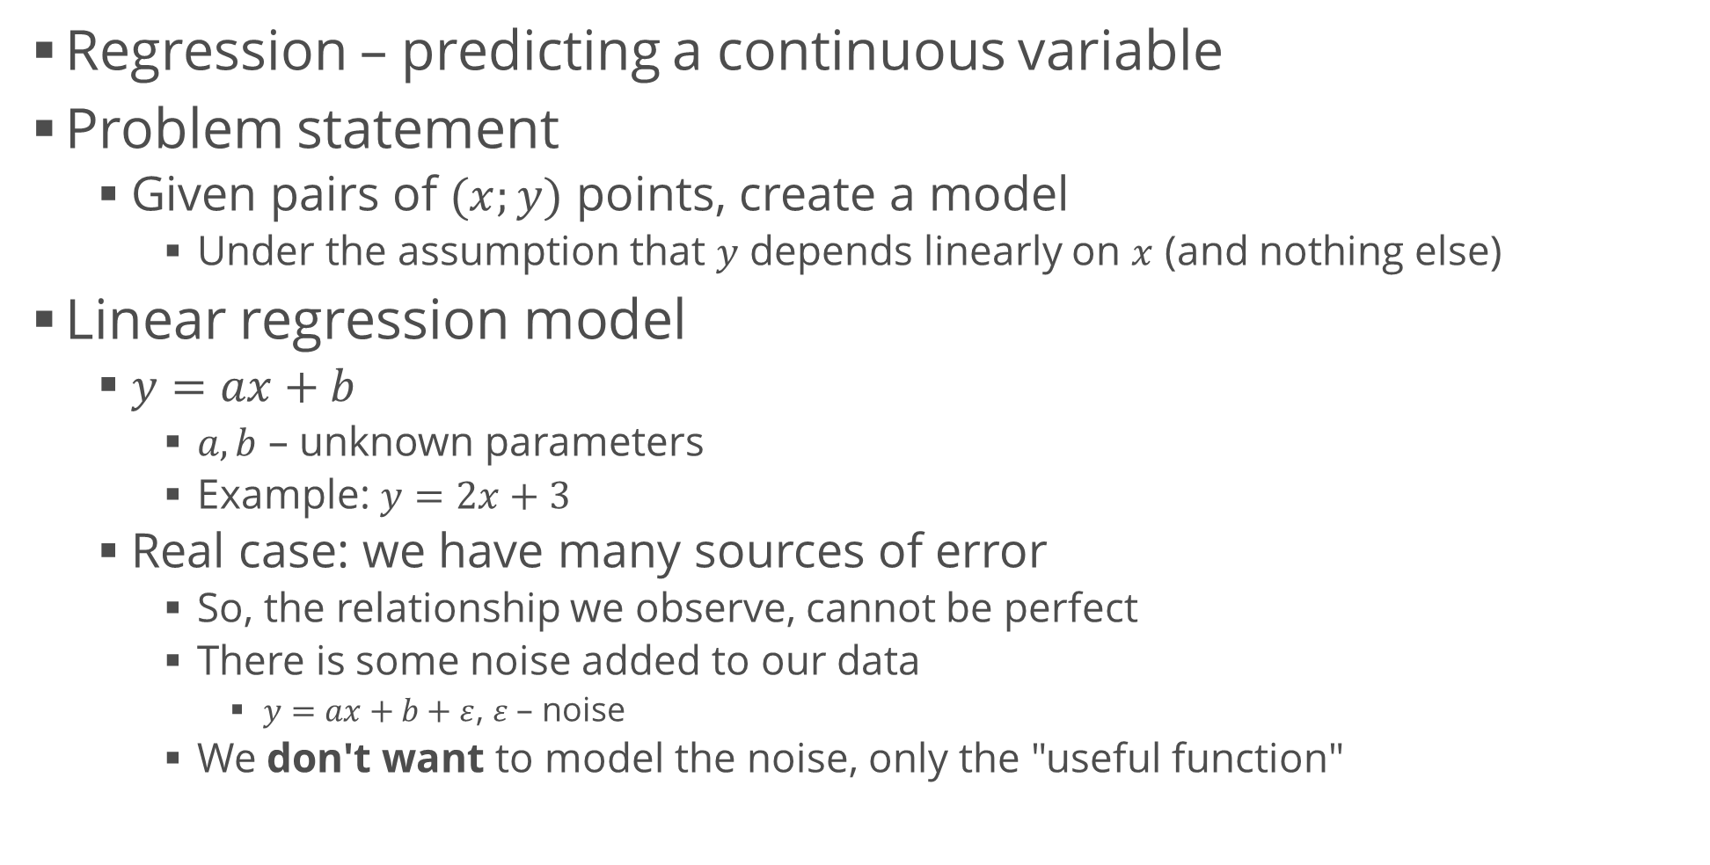
Linear Regression Intuition
Regression – predicting a continuous variable
Problem statement
Given pairs of $(x;y)$ points, create a model
Under the assumption that $y$ depends linearly on $x$ (and nothing else)
Linear regression model
$y=ax+b$
$a, b$ – unknown parameters
Example: $y=2x+3$
Real case: we have many sources of error
So, the relationship we observe, cannot be perfect
There is some noise added to our data
$y=ax+b+ε$, $ε$ – noise
We don't want to model the noise, only the "useful function"

Slide 10
Generating Data Points
Generating a few "ideal" data points is easy
Adding noise – draw from a random distribution
If we want, we can even configure the "size" of our noise
More noise = worse data = less accurate predictions
x = np.linspace(-3, 5, 10)
y = 2 * x + 3
plt.scatter(x, y)
plt.xlabel("x")
plt.ylabel("y")
plt.show()
y_noise = np.random.normal(size = len(y))
y_with_noise = y + y_noise
plt.scatter(x, y_with_noise)
plt.xlabel("x")
plt.ylabel("y")
plt.show()

Slide 11
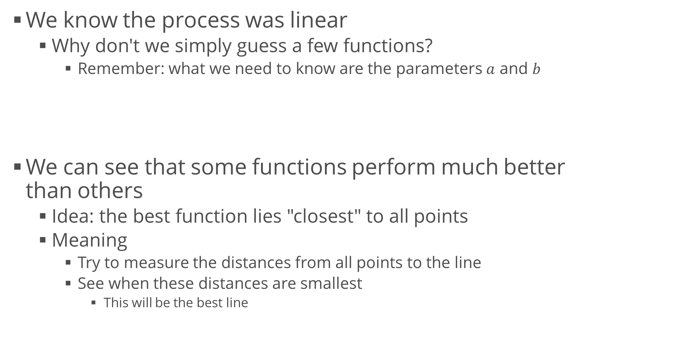
First Attempt at Modelling
We know the process was linear
Why don't we simply guess a few functions?
Remember: what we need to know are the parameters $a$ and $b$
We can see that some functions perform much better than others
Idea: the best function lies "closest" to all points
Meaning
Try to measure the distances from all points to the line
See when these distances are smallest
This will be the best line
for y_guess in [3 * x + 8, 4 * x + 3, -2 * x]:
plt.scatter(x, y_with_noise)
plt.plot(x, y_guess)
plt.show()

Slide 12
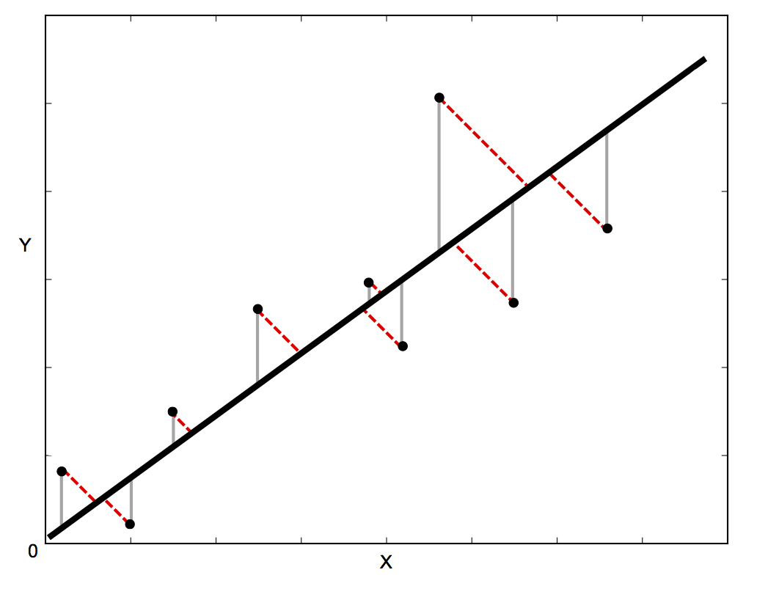
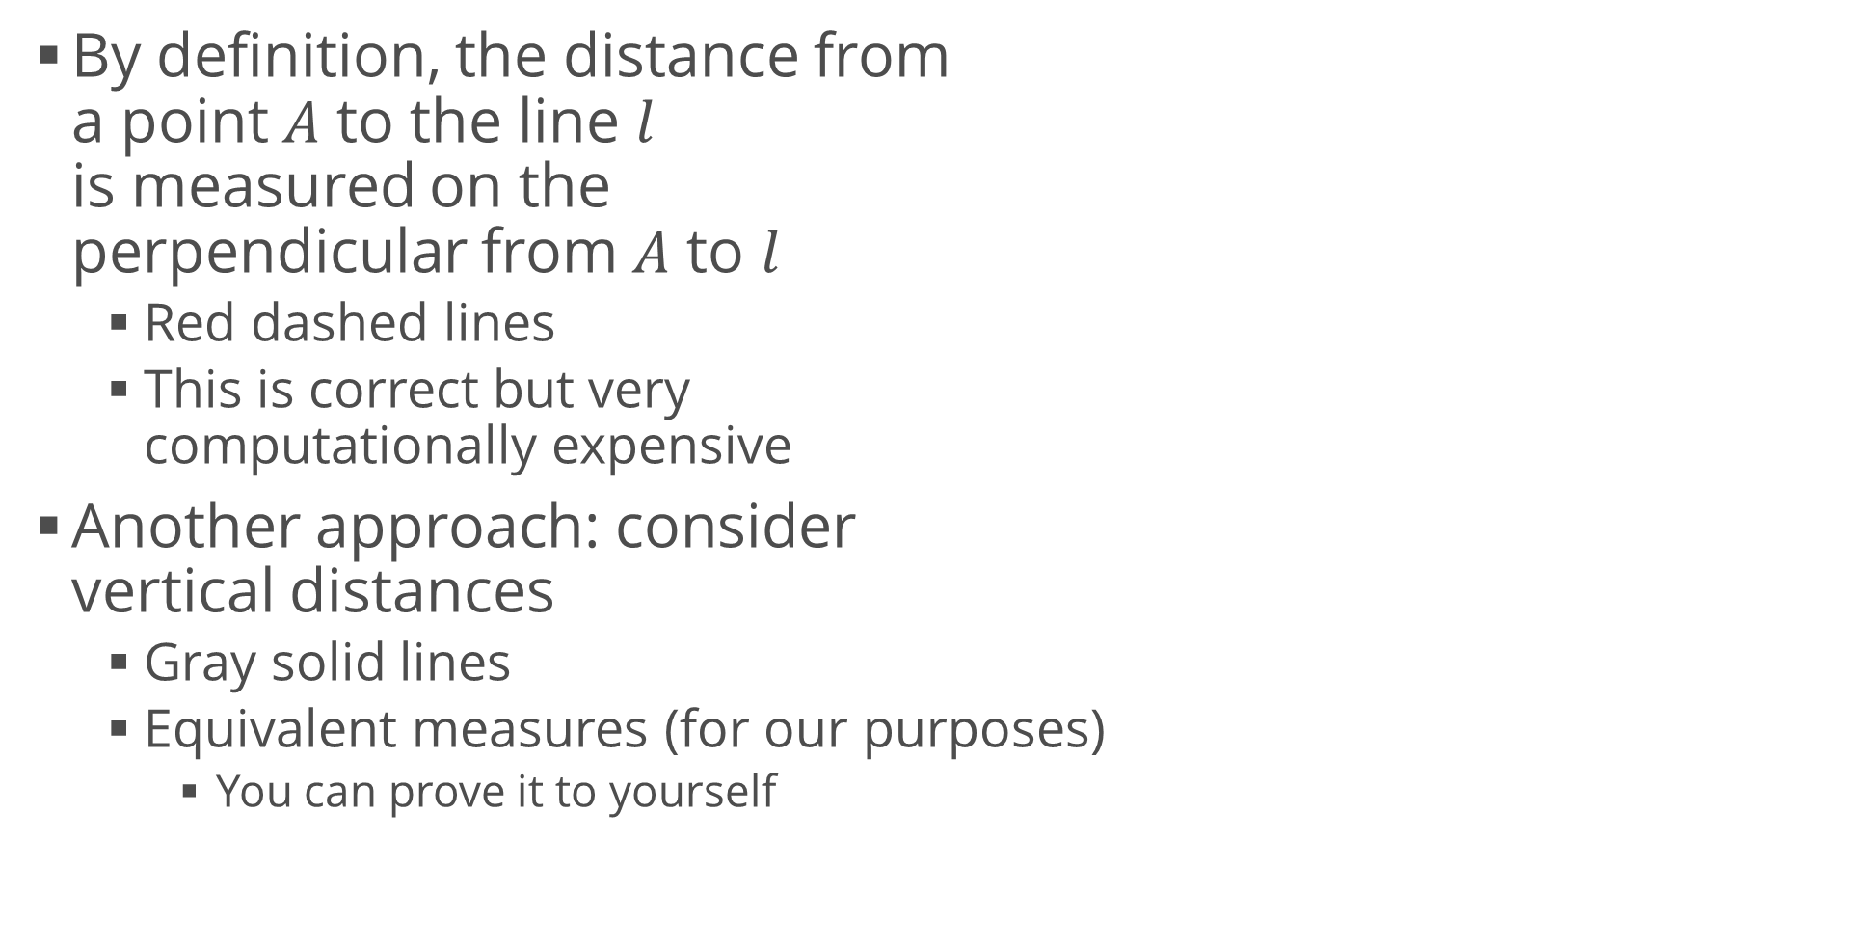
Distances
By definition, the distance from a point $A$ to the line $l$ is measured on the perpendicular from $A$ to $l$
Red dashed lines
This is correct but very computationally expensive
Another approach: consider vertical distances
Gray solid lines
Equivalent measures (for our purposes)
You can prove it to yourself

Slide 13
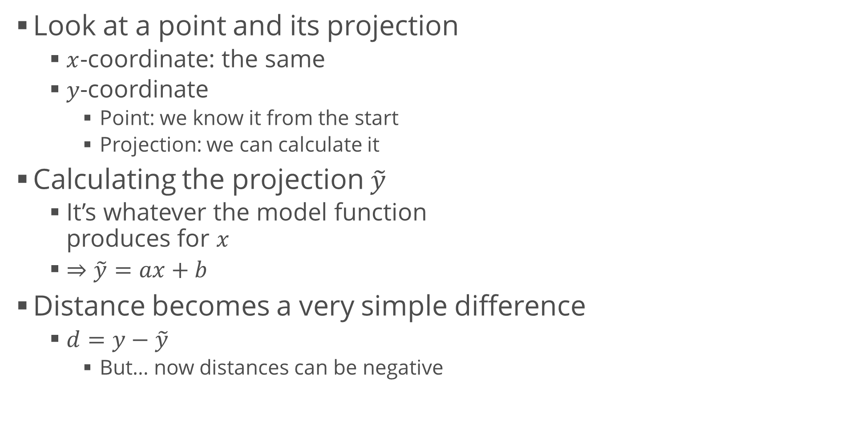
Distances (2)
Look at a point and its projection
$x$-coordinate: the same
$y$-coordinate
Point: we know it from the start
Projection: we can calculate it
Calculating the projection $\tilde{y}$
It’s whatever the model function produces for $x$
$⇒\tilde{y}=ax+b$
Distance becomes a very simple difference
$d=y−\tilde{y}$
But… now distances can be negative

Slide 14
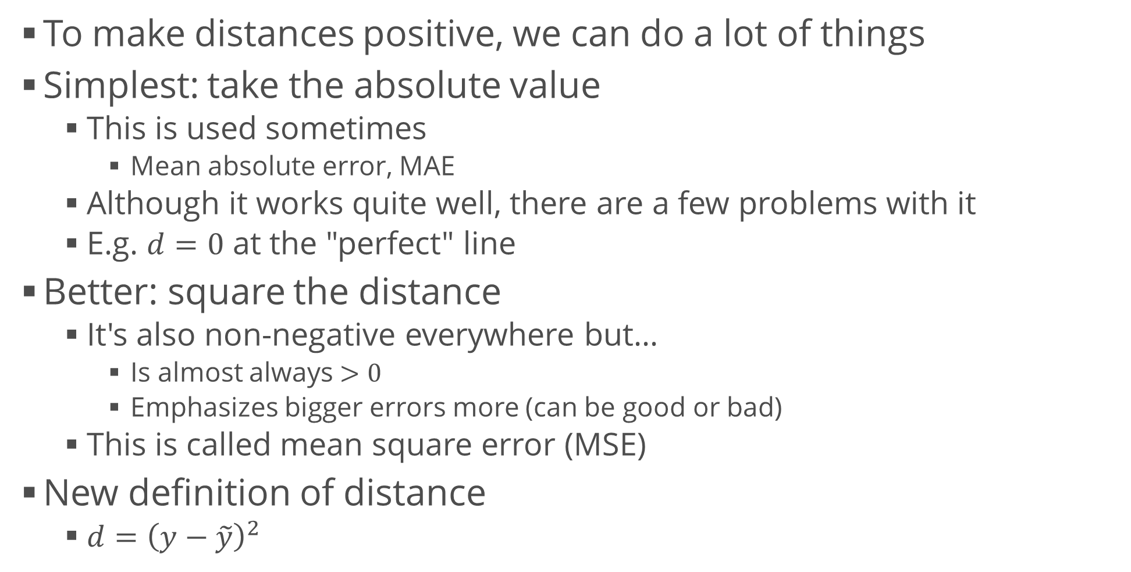
Distances (3)
To make distances positive, we can do a lot of things
Simplest: take the absolute value
This is used sometimes
Mean absolute error, MAE
Although it works quite well, there are a few problems with it
E.g. $d=0$ at the "perfect" line
Better: square the distance
It's also non-negative everywhere but…
Is almost always $>0$
Emphasizes bigger errors more (can be good or bad)
This is called mean square error (MSE)
New definition of distance
$d={\left(y−\tilde{y}\right)}^{2}$

Slide 15
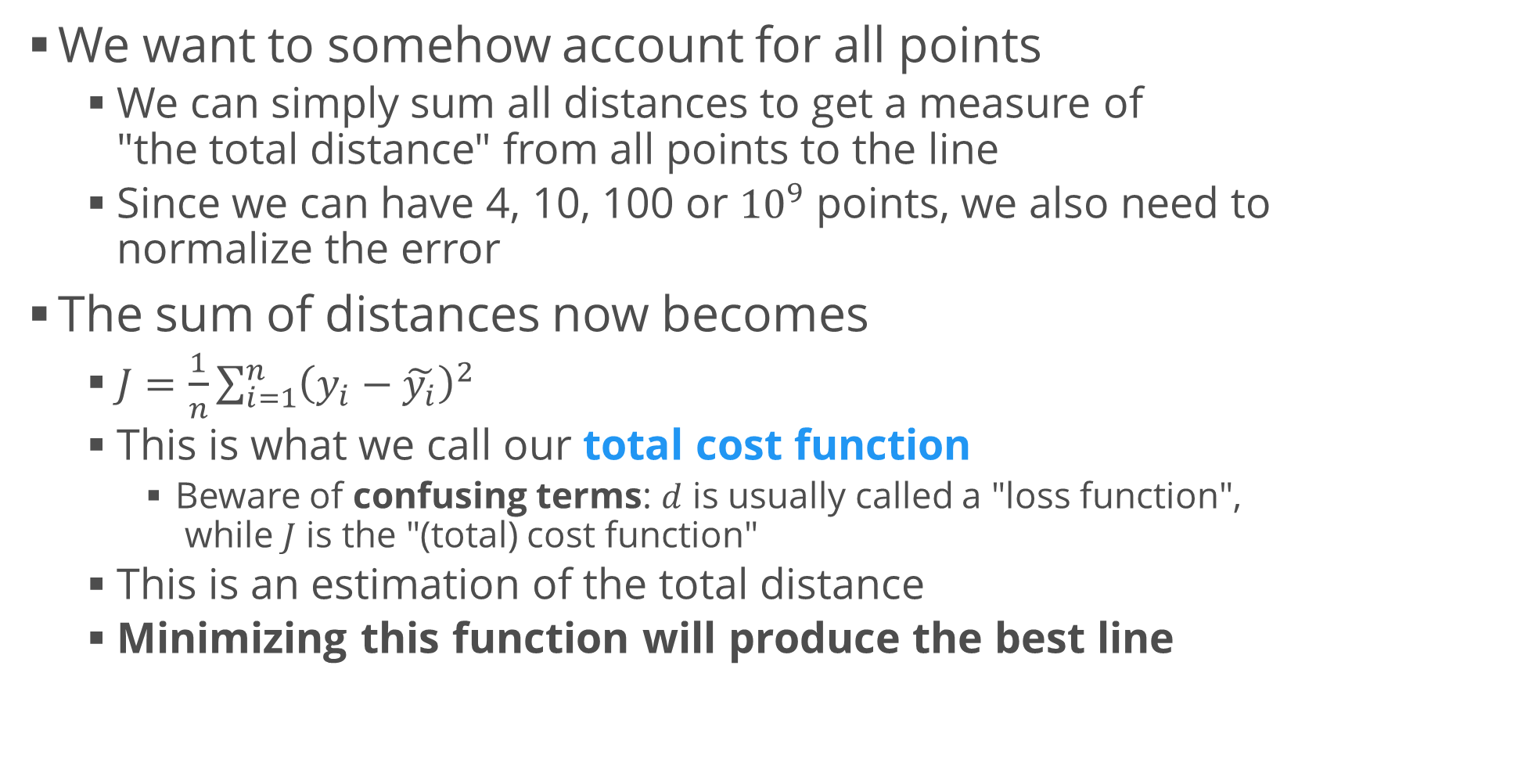
Cost Function
We want to somehow account for all points
We can simply sum all distances to get a measure of "the total distance" from all points to the line
Since we can have 4, 10, 100 or ${10}^{9}$ points, we also need to normalize the error
The sum of distances now becomes
$J=\frac{1}{n}\sum_{i=1}^{n}{{\left(y_{i}−\tilde{y_{i}}\right)}^{2}}$
This is what we call our total cost function
Beware of confusing terms: $d$ is usually called a "loss function", while $J$ is the "(total) cost function"
This is an estimation of the total distance
Minimizing this function will produce the best line

Slide 16
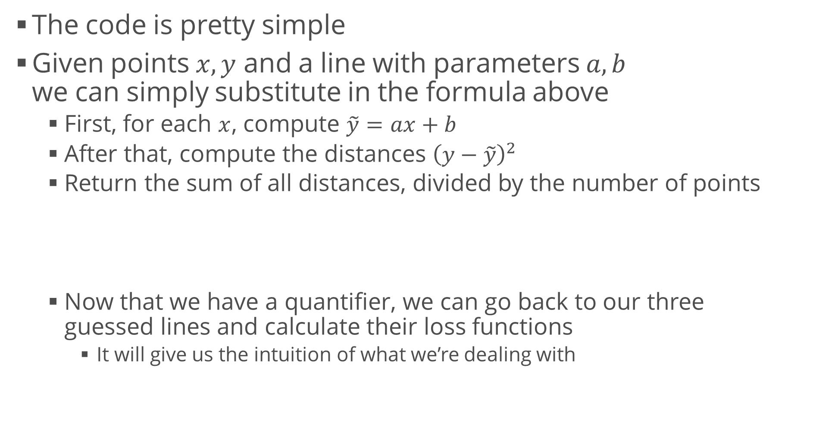
Calculating the Loss Function
The code is pretty simple
Given points $x, y$ and a line with parameters $a,b$ we can simply substitute in the formula above
First, for each $x$, compute $\tilde{y}=ax+b$
After that, compute the distances ${\left(y−\tilde{y}\right)}^{2}$
Return the sum of all distances, divided by the number of points
Now that we have a quantifier, we can go back to our three guessed lines and calculate their loss functions
It will give us the intuition of what we’re dealing with
def calculate_loss(x, y, a, b):
y_predicted = a * x + b
distances = (y - y_predicted) ** 2
return np.sum(distances) / len(x)

Slide 17
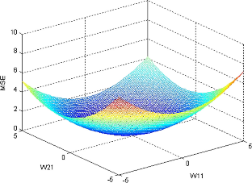
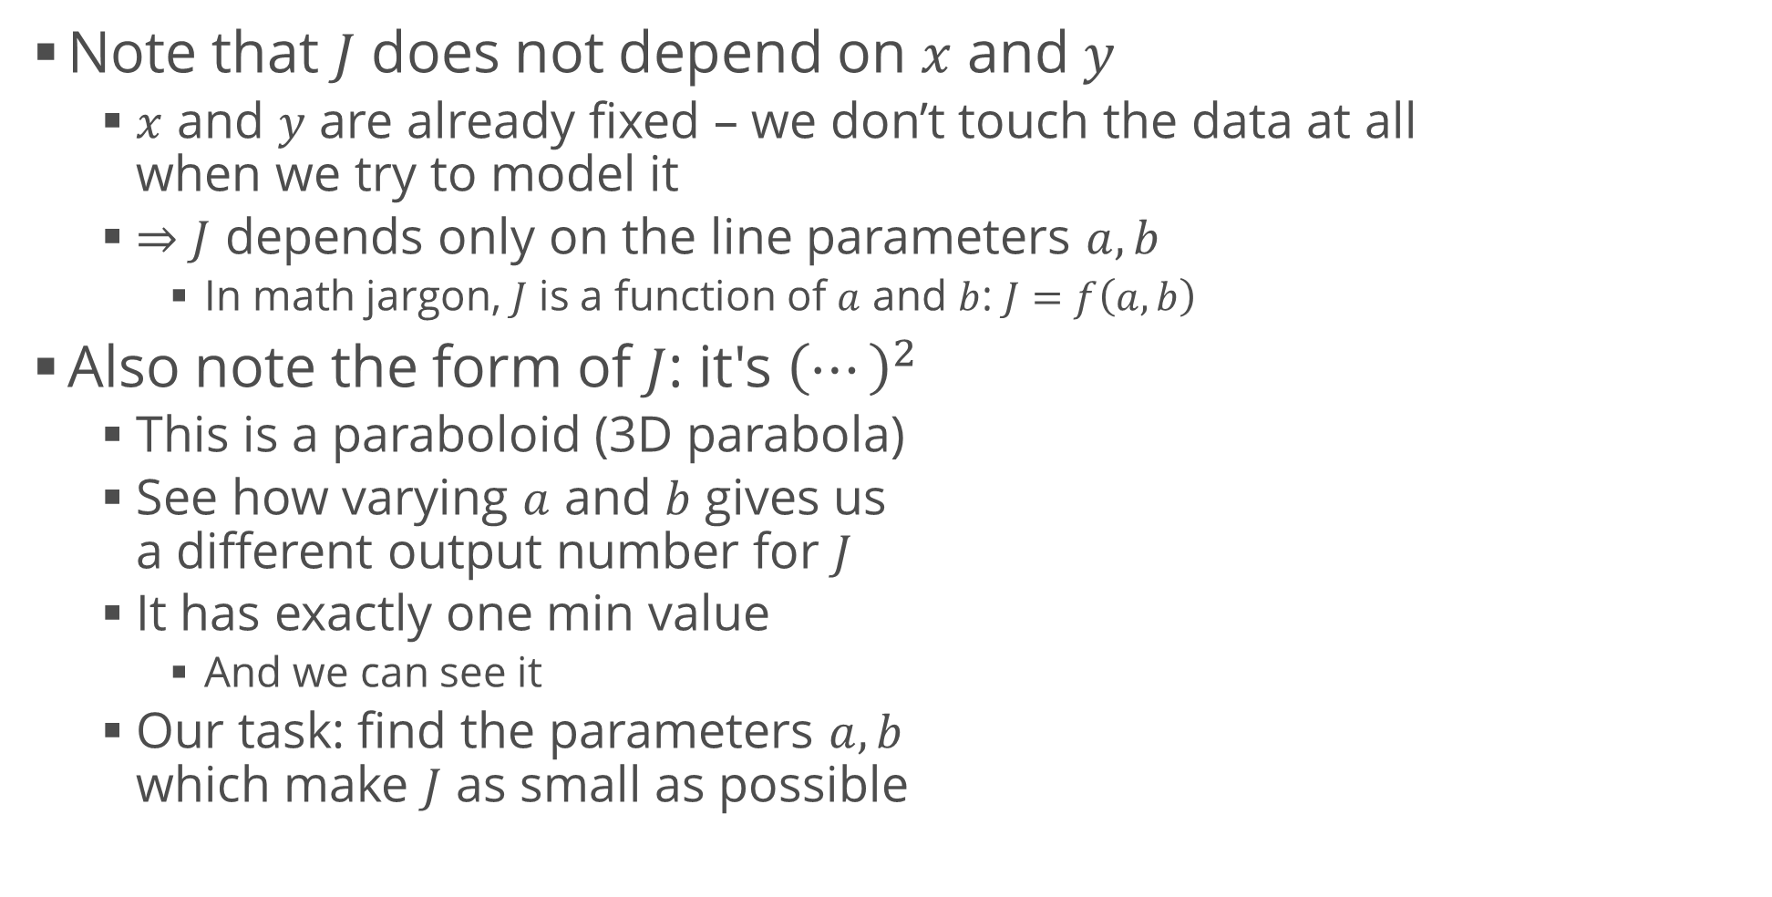
Inspecting the Loss Function
Note that $J$ does not depend on $x$ and $y$
$x$ and $y$ are already fixed – we don’t touch the data at all when we try to model it
$⇒J$ depends only on the line parameters $a, b$
In math jargon, $J$ is a function of $a$ and $b$: $J=f\left(a,b\right)$
Also note the form of $J$: it's ${\left(⋯\right)}^{2}$
This is a paraboloid (3D parabola)
See how varying $a$ and $b$ gives us a different output number for $J$
It has exactly one min value
And we can see it
Our task: find the parameters $a, b$ which make $J$ as small as possible

Slide 18
Minimizing the Loss Function
Intuition
If the plot was a real object (say, a sheet of some sort), we could slide a ball bearing on it
After a while, the ball bearing will settle at the "bottom" due to gravity
We could measure the position of the ball and that's it :)
More "nerd speak"
This is the same task – we have a gravity potential energy that the ball tries to minimize
When it's minimal, the ball remains in stable equilibrium

Slide 19
Minimizing the Loss Function (2)
Turns out, we can also do this using calculus
In many dimensions
We can find the optimal parameters right away
Because the function is really simple
But we'll stick to another approach because this is what is useful for all other ML tasks
We'll try to replicate the example with the ball
Basically, we'll try to slide (descend) over the function surface until we reach the minimum
This method is called gradient descent

Slide 20
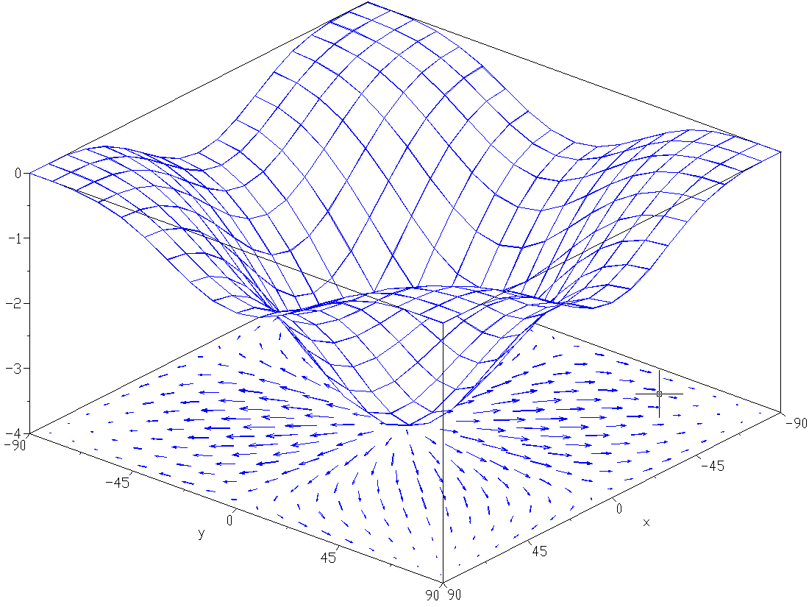
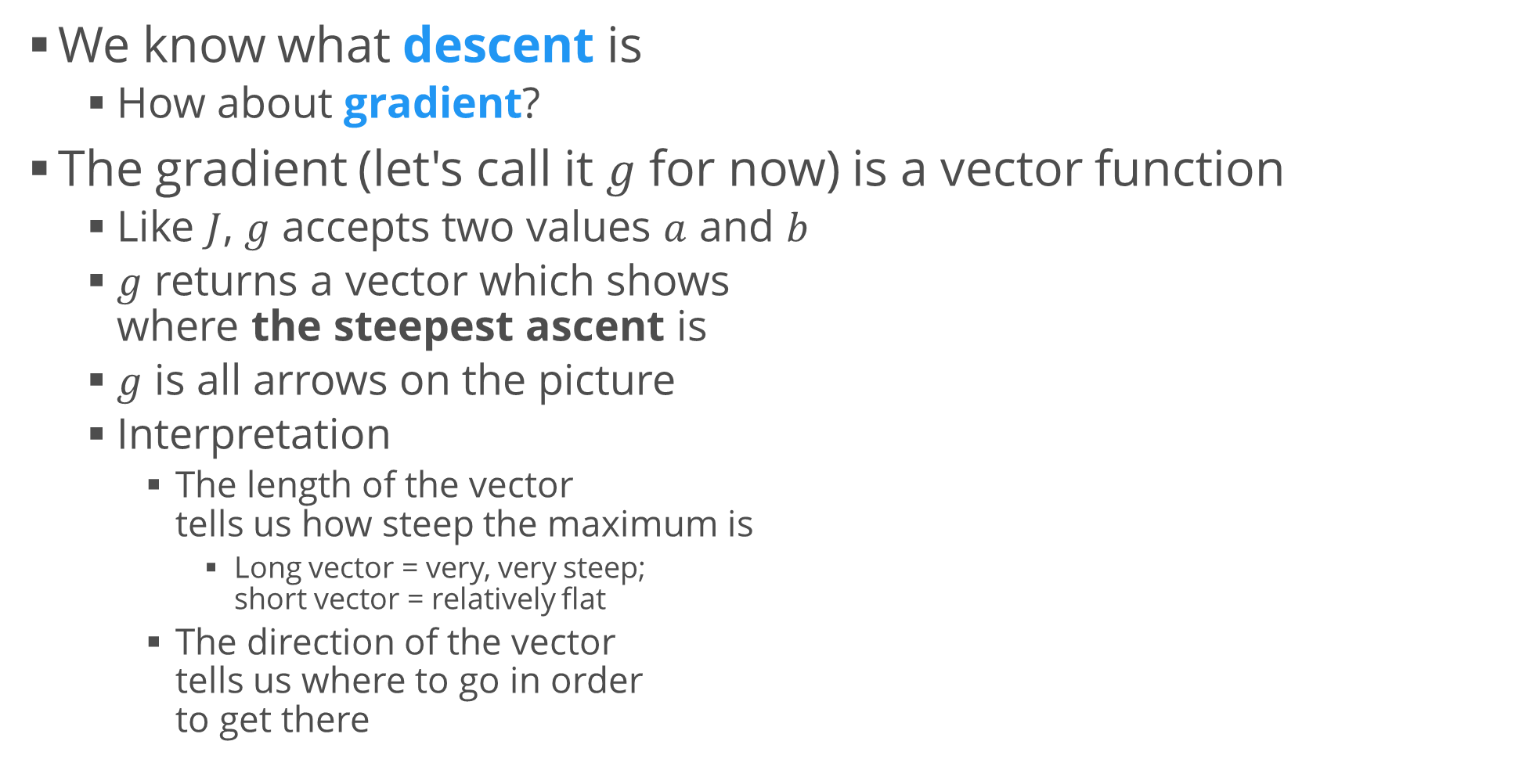
Gradient Descent
We know what descent is
How about gradient?
The gradient (let's call it $g$ for now) is a vector function
Like $J$, $g$ accepts two values $a$ and $b$
$g$ returns a vector which shows where the steepest ascent is
$g$ is all arrows on the picture
Interpretation
The length of the vector tells us how steep the maximum is
Long vector = very, very steep; short vector = relatively flat
The direction of the vector tells us where to go in order to get there

Slide 21
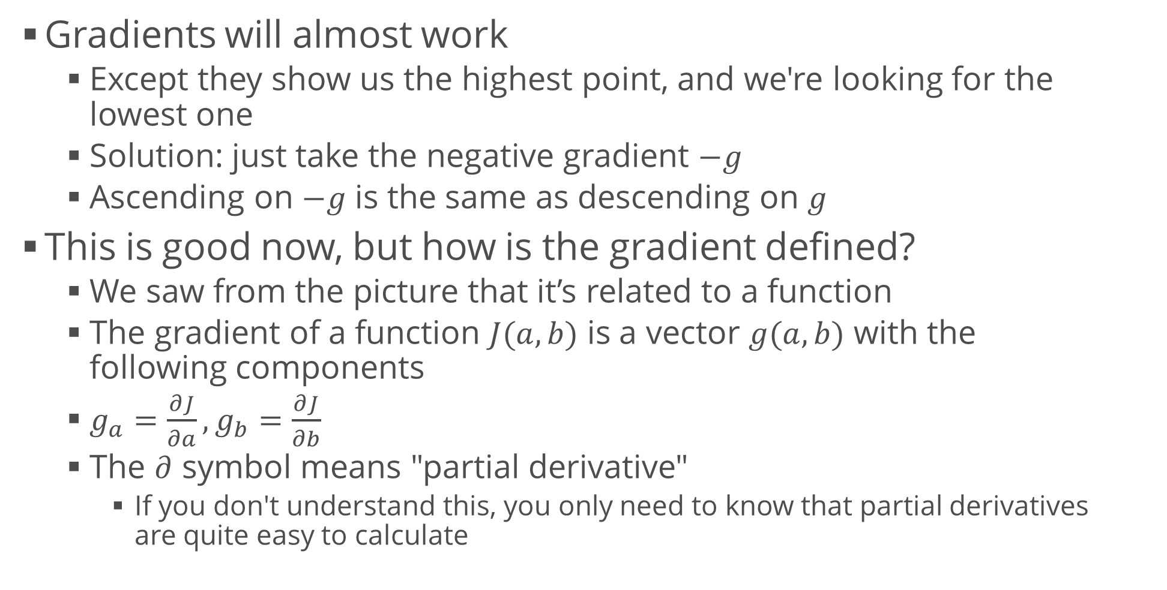
Gradient Descent (2)
Gradients will almost work
Except they show us the highest point, and we're looking for the lowest one
Solution: just take the negative gradient $−g$
Ascending on $−g$ is the same as descending on $g$
This is good now, but how is the gradient defined?
We saw from the picture that it’s related to a function
The gradient of a function $J(a,b)$ is a vector $g(a,b)$ with the following components
$g_{a}=\frac{∂J}{∂a}, g_{b}=\frac{∂J}{∂b}$
The $∂$ symbol means "partial derivative"
If you don't understand this, you only need to know that partial derivatives are quite easy to calculate

Slide 22
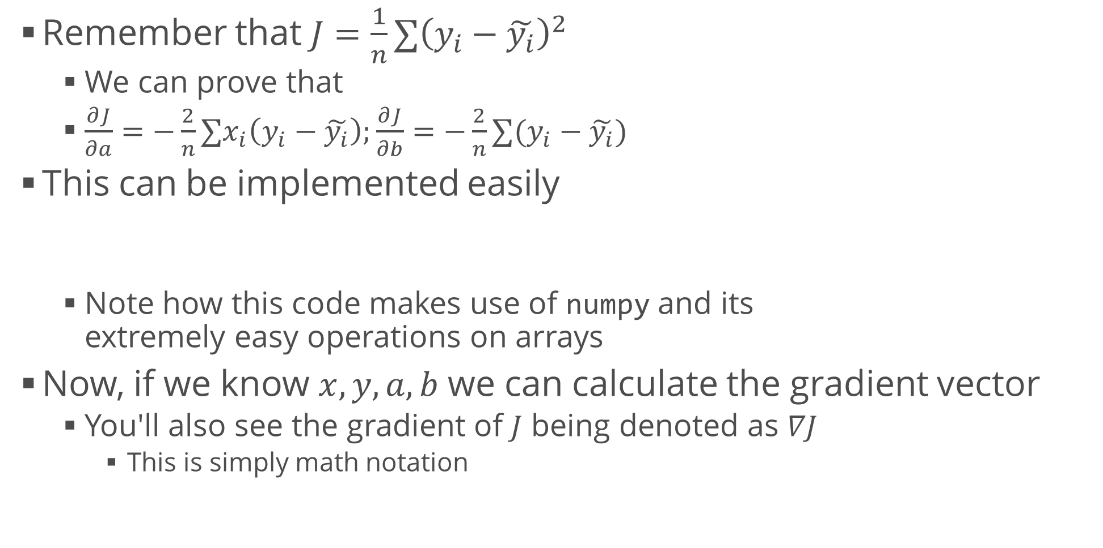
Gradient Descent (3)
Remember that $J=\frac{1}{n}∑{\left(y_{i}−\tilde{y_{i}}\right)}^{2}$
We can prove that
$\frac{∂J}{∂a}=−\frac{2}{n}∑x_{i}\left(y_{i}−\tilde{y_{i}}\right);\frac{∂J}{∂b}=−\frac{2}{n}∑(y_{i}−\tilde{y_{i}})$
This can be implemented easily
Note how this code makes use of numpy and its extremely easy operations on arrays
Now, if we know $x, y, a,b$ we can calculate the gradient vector
You'll also see the gradient of $J$ being denoted as $∇J$
This is simply math notation
a_gradient = -2 / len(x) * np.sum(x * (y - (a * x + b)))
b_gradient = -2 / len(y) * np.sum(y - (a * x + b))

Slide 23
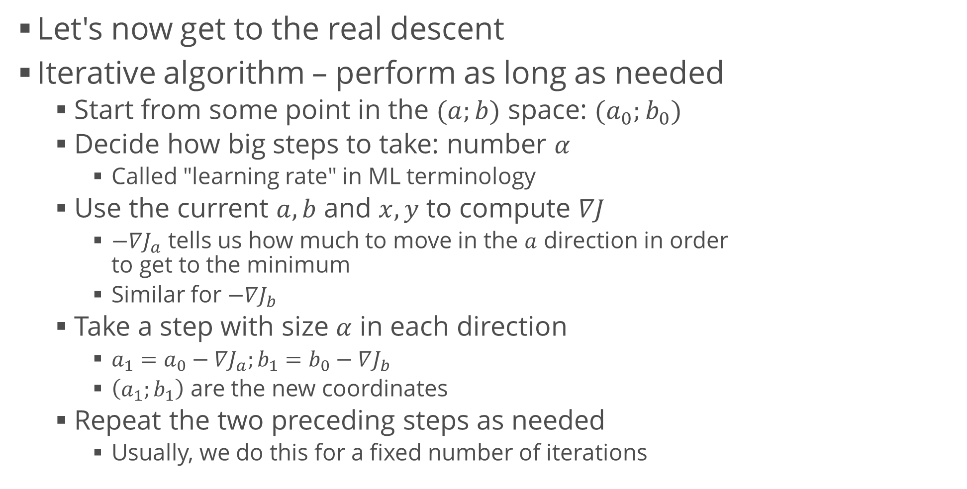
Gradient Descent (4)
Let's now get to the real descent
Iterative algorithm – perform as long as needed
Start from some point in the $(a;b)$ space: $(a_{0};b_{0})$
Decide how big steps to take: number $α$
Called "learning rate" in ML terminology
Use the current $a,b$ and $x,y$ to compute $∇J$
$−∇J_{a}$ tells us how much to move in the $a$ direction in order to get to the minimum
Similar for $−∇J_{b}$
Take a step with size $α$ in each direction
$a_{1}=a_{0}−∇J_{a};b_{1}=b_{0}−∇J_{b}$
$\left(a_{1};b_{1}\right)$ are the new coordinates
Repeat the two preceding steps as needed
Usually, we do this for a fixed number of iterations

Slide 24
Gradient Descent Code
Gradient descent step
Entire process: 1000 iterations
def perform_gradient_descent(x, y, a, b, learning_rate):
a_gradient = -2 / len(x) * np.sum(x * (y - (a * x + b)))
b_gradient = -2 / len(y) * np.sum(y - (a * x + b))
new_a = a - a_gradient * learning_rate
new_b = b - b_gradient * learning_rate
return (new_a, new_b)
model_a, model_b = -10, 20 # Start points; can be anywhere
alpha = 0.01 # Learning rate for step in range(1001):
model_a, model_b = perform_gradient_descent( data_x, data_y, model_a, model_b, alpha)
if step % 100 == 0:
error = calculate_loss(data_x, data_y, model_a, model_b)
print("Step {}: a = {}, b = {}, J = {}".format( step, model_a, model_b, error))
print("Final line: {} * x + {}".format(model_a, model_b))

Slide 25
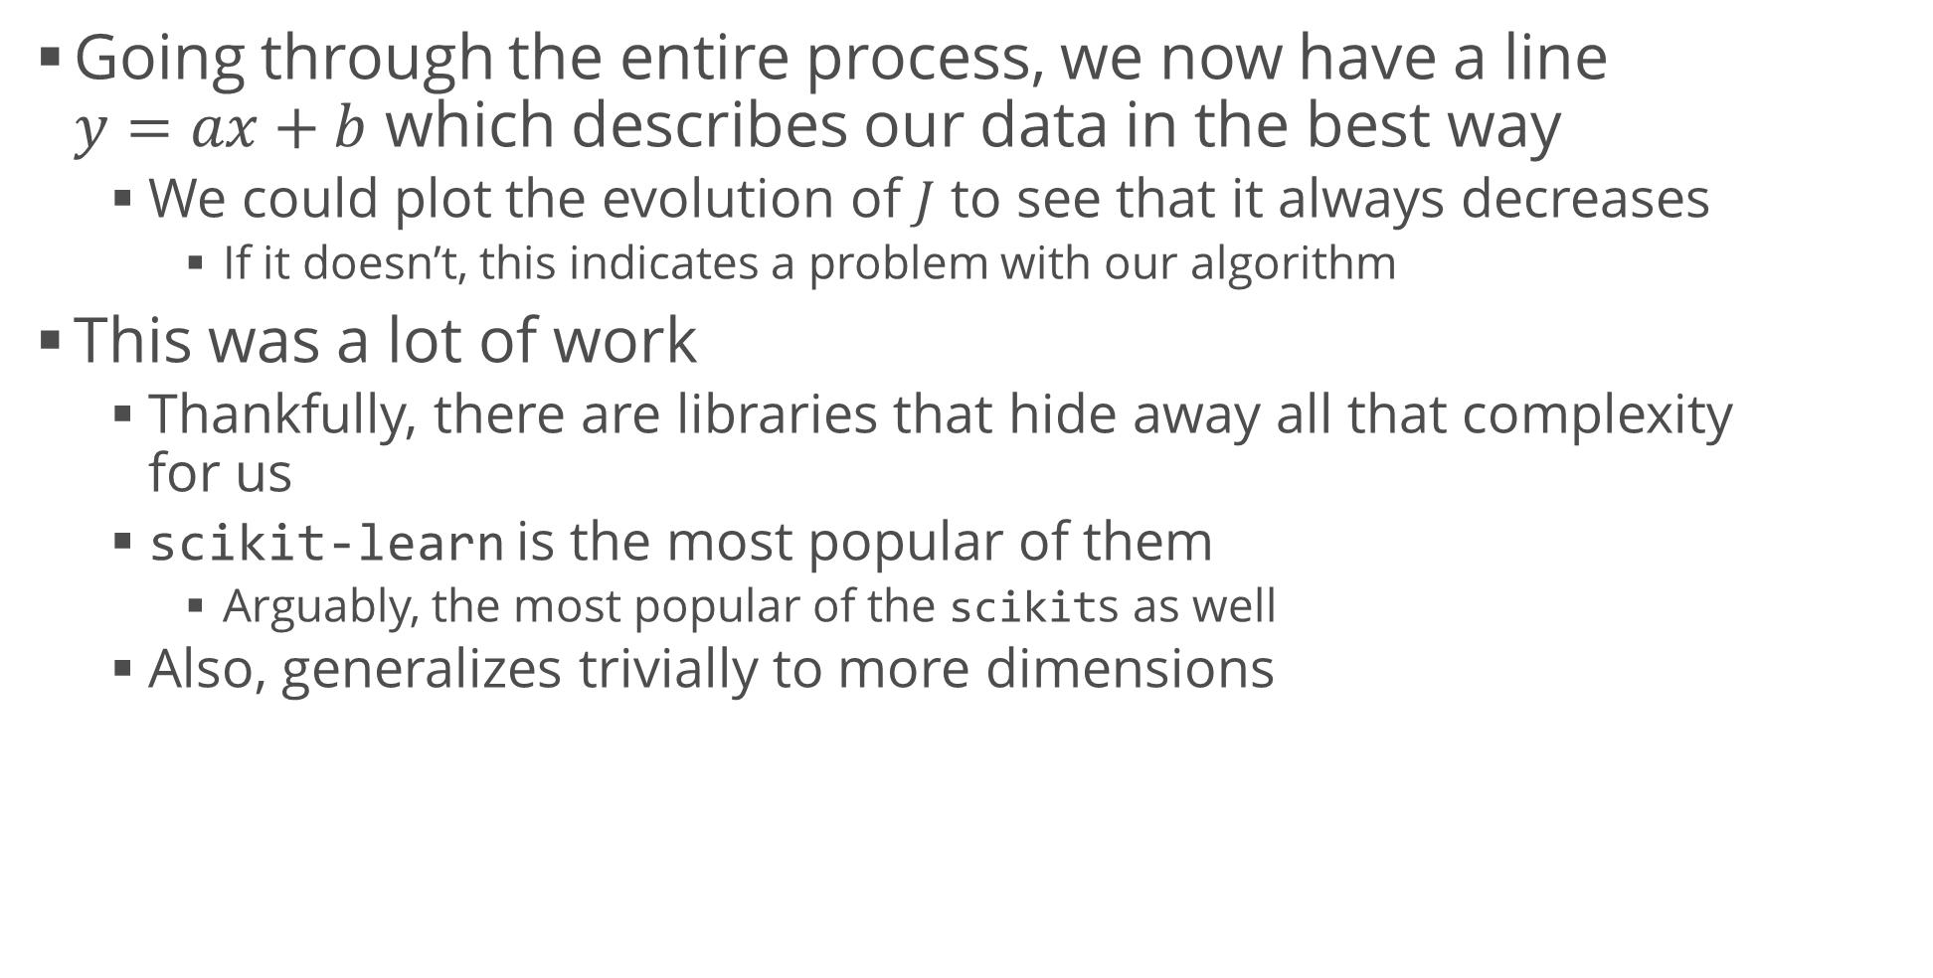
Results and Interpretation
Going through the entire process, we now have a line $y=ax+b$ which describes our data in the best way
We could plot the evolution of $J$ to see that it always decreases
If it doesn’t, this indicates a problem with our algorithm
This was a lot of work
Thankfully, there are libraries that hide away all that complexity for us
scikit-learn is the most popular of them
Arguably, the most popular of the scikits as well
Also, generalizes trivially to more dimensions
from sklearn.linear_model import LinearRegression
model = LinearRegression()
model.fit(data_x.reshape(-1, 1), data_y)
print(model.coef_, model.intercept_)

Slide 26
Logistic Regression
Use a regression model to classify

Slide 27
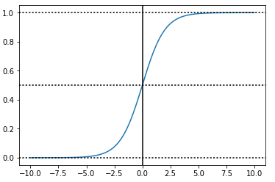
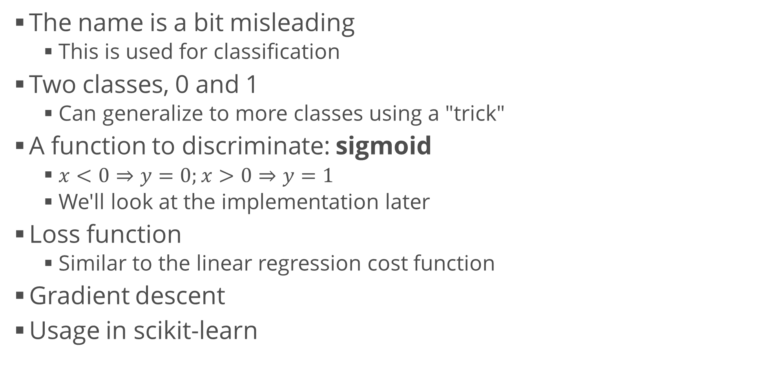
Logistic Regression
The name is a bit misleading
This is used for classification
Two classes, 0 and 1
Can generalize to more classes using a "trick"
A function to discriminate: sigmoid
$x<0⇒y=0;x>0⇒y=1$
We'll look at the implementation later
Loss function
Similar to the linear regression cost function
Gradient descent
Usage in scikit-learn
from sklearn.linear_model import LogisticRegression

Slide 28
Overview of the Process
We dealt mainly with the modelling part
It's only a piece of the puzzle
Many algorithms to choose from
Each with its own features and drawbacks
Many ways to test that we're on a correct path
The end result depends mainly on
The person working on the dataset
The data quality
Less prominent but also worth mentioning
Data size (bigger is usually better)
Data acquisition and sampling processes

Slide 29
Summary
Problem overview
Regression, classification
Machine learning: putting it all together
Linear regression
Motivation, derivation, usage
More involved example
Logistic regression
Motivation, usage

